Slide 1
NBA DATABASE Team Aspire
Michael chen
Adeel Asghar
Bashaar shah

Slide 2
CRUD Application
Database that contains information for the 2017-2018 NBA season
May add on additional seasons and playoff statistics
Contains Team and current rosters and statistics
Accolades for the season
Controls
Add player
Remove player
Edit stats
Back to Menu

Slide 3
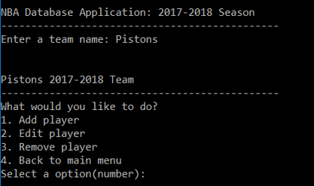
GUI Interface
Will use QT to develop a GUI
Transform command prompt into clean interface
Command Prompt Menu

Slide 4

Statistics
Player PPG, APG, RPG, SPG, BPG and along with shooting splits including advanced statistics
Accolades of the season including MVP, DPOY, ROY, SMOY, MIP, COY, and All-NBA Teams

